Slide 1


SUPERVISED BY
Dr. D. DhinaKaran, M.E., Ph.D.
PRESENTED BY
1. Lokeshwar (22202)(22UECS0366)
2. Sushma (21849)(22UECS0325)
3. Deekshitha (21745)(22UECS0645)

Slide 2
MediXpert Application
AGENDA
Introduction
Literature Survey
Problem Statement
Proposed Methodology
Proposed System Architecture
Implementation
Testing & Validation
Results & Discussion
Conclusion and Future Work
References

Slide 3
Introduction
Problem Statement:
Accurate diagnosis of diseases like brain tumors, pneumonia, and bone fractures often relies on expert interpretation of medical images such as MRI scans, chest X-rays, and bone X-rays. However, in many healthcare settings—particularly in rural and underserved regions—access to trained radiologists is limited, leading to delays in diagnosis and treatment. Additionally, manual analysis of medical images is time-consuming, prone to human error, and becomes increasingly difficult with the rising volume of imaging data. MediXpert addresses this critical need by providing an AI-powered, Flask-based web application that can automatically detect and classify brain tumors, pneumonia, and bone fractures from medical images. The system aims to assist medical professionals by delivering fast, reliable, and consistent diagnostic support, ultimately enhancing clinical decision-making and improving patient outcomes.

Slide 4
Project Goal:
The primary goal of MediXpert is to develop an intelligent, AI-driven web application capable of assisting healthcare professionals in the early detection of brain tumors, pneumonia, and bone fractures using medical imaging. By integrating Convolutional Neural Networks (CNNs) with a Flask-based interface, the project aims to provide a fast, accessible, and reliable diagnostic tool that can analyze uploaded MRI and X-ray images in real-time. The system is designed to reduce the dependency on manual image interpretation, minimize diagnostic delays, and make advanced medical analysis more widely available—especially in regions with limited access to radiologists. Ultimately, Medixpert strives to enhance medical outcomes through the use of deep learning technologies in clinical workflows.

Slide 5
Brief Overview:
Medixpert is an AI-powered medical diagnostic web application designed to assist doctors and healthcare professionals in detecting critical conditions such as brain tumors, pneumonia, and bone fractures. Built using the Flask web framework and integrated with deep learning models, the system allows users to upload medical images—such as MRI scans or X-rays—and receive instant diagnostic predictions. Each condition is handled by a specialized Convolutional Neural Network (CNN) trained on curated medical datasets to ensure high accuracy and reliability. The platform is designed to be user-friendly, fast, and accessible, making it particularly valuable in areas where radiological expertise is scarce. Medixpert bridges the gap between AI and healthcare by providing intelligent support in medical image interpretation, ultimately improving diagnostic speed and quality.

Slide 6
Literature Survey
Existing Systems:
In the current medical diagnostic system, bone fractures and pneumonia are primarily detected through traditional radiographic imaging methods such as X-rays, CT scans, and MRIs. Radiologists and medical professionals manually analyze these images to diagnose fractures and lung infections. While this method is effective, it has several limitations:
Time-Consuming – Manual analysis of medical images is slow, leading to delays in diagnosis and treatment.
Human Error – Misinterpretation of X-rays and scans due to fatigue or expertise level differences can lead to misdiagnosis.
Lack of Automation – Existing systems do not leverage AI or ML for automated detection, requiring complete reliance on human expertise.

Slide 7
Related works:
Several research studies and AI-driven medical applications have been developed to address the limitations of traditional diagnostic systems. Some notable works include:
AI in Medical Imaging – AI models, such as convolutional neural networks (CNNs), have been extensively studied for medical image analysis, showing promising results in fracture and lung disease detection. These models automate the process of feature extraction and classification, significantly improving diagnostic accuracy.
Brain Tumor Detection using CNNs – Research has demonstrated the effectiveness of CNN-based models in automatically detecting and segmenting brain tumors in MRI images. These models achieve high accuracy in distinguishing between benign and malignant tumors.
Pneumonia Detection using Deep Learning – Deep learning models, particularly CNNs, have been widely used for detecting pneumonia in chest X-ray images. These models outperform traditional methods by accurately classifying viral and bacterial pneumonia.
Computer-Aided Diagnosis (CAD) Systems – CAD tools have been used in medical imaging to assist radiologists by highlighting potential abnormalities in X-rays, MRIs, and CT scans. These systems improve diagnostic efficiency and reduce human error.

Slide 8
Problem Statement
Early and accurate diagnosis of medical conditions like brain tumors, pneumonia, and bone fractures is crucial for effective treatment.
Manual Diagnosis:The process is time-consuming, delaying critical treatment for patients.
Limited Access to Specialists:In remote or underserved areas, access to skilled radiologists is often limited, resulting in delayed or missed diagnoses.
High Costs:Advanced diagnostic tools and expert consultations are expensive, making them inaccessible to many patients.
Increasing Workload:With the growing number of patients, healthcare systems are overburdened, leading to longer wait times and reduced accuracy.
Lack of Scalability:Existing solutions are often not scalable and cannot handle the increasing volume of medical imaging data efficiently.

Slide 9
Proposed Methodology
Data Collection:
Gather labeled datasets for brain tumor, pneumonia, and bone fracture detection from reliable sources (e.g., Kaggle, open medical databases).
Data Preprocessing:
Resize and normalize images for consistent input shape.
Apply data augmentation techniques (rotation, flipping, zooming) to improve model robustness.
Model Development:
Design and train three separate CNN models—one for each medical condition.
Use layers like Conv2D, MaxPooling, ReLU, and Dense.
Implement dropout and batch normalization to prevent overfitting.

Slide 10
Model Evaluation:
Validate models using accuracy, precision, recall, and confusion matrix.
Fine-tune hyperparameters for better performance.
Integration with Flask:
Deploy the trained models into a Flask-based web application.
Build routes to handle image upload and prediction requests.
User Interaction:
Users upload MRI or X-ray images through a web interface.
Backend processes the image and returns the predicted result (e.g., Tumor Detected / No Tumor).
Result Display:
Display prediction outcome in a clear, user-friendly format.
Optionally, include confidence scores or visual feedback.

Slide 11
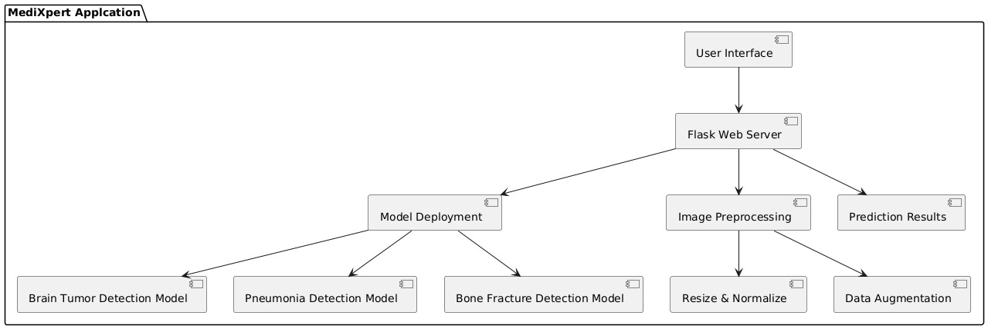
Proposed System Architecture

Slide 12
The process begins when the user accesses the Flask-based web application. Users upload an image (e.g., MRI or X-ray) through the web interface, initiating an HTTP POST request to the backend. Once the image is received, it undergoes data preprocessing, including steps like resizing and normalizing the image to ensure consistent input for the model. Additionally, data augmentation techniques (e.g., rotation, flipping, zooming) are applied to improve the robustness of the model. After preprocessing, the backend selects the appropriate CNN model based on the type of medical condition (brain tumor, pneumonia, or bone fracture). The image is then fed into the model, where the network processes the data using layers such as Conv2D, MaxPooling, ReLU, and Dense. The model evaluation process takes place, where accuracy, precision, recall, and confusion matrix metrics are used to assess the prediction.

Slide 13
Summary of Module -1
1. Image Upload and Preprocessing Module:
Handles the uploading of medical images and prepares them for analysis by the CNN models.
File Upload:
Accepts medical images in formats like JPEG, PNG, and DICOM.
Validates file type and size to ensure compatibility.
Provides feedback to the user if the file is invalid or unsupported.
Unique Filename Generation:
Uses uuid to generate unique filenames for uploaded images.
Prevents filename conflicts and ensures secure file storage.
Image Preprocessing:
Resizes images to the required dimensions (e.g., 150x150) for model input.
Normalizes pixel values to a range of [0, 1] for better model performance.
Converts images to NumPy arrays for compatibility with TensorFlow/Keras models.

Slide 14
Summary of Module -2
2. CNN-Based Detection Module:
Contains the CNN models for detecting brain tumors, pneumonia, and bone fractures.
Model Loading:
Loads pre-trained CNN models for each detection task.
Ensures models are loaded only once during application startup for efficiency.
Prediction:
Runs the preprocessed image through the appropriate model.
Returns the prediction result as a probability score (e.g., 0.85 for 85% confidence).
Model-Specific Input Requirements:
Ensures each model receives input in the correct format (e.g., resized and normalized images).
Performance Optimization:
Uses GPU acceleration (if available) for faster inference.

Slide 15
Summary of Modules -3
3.Result Interpretation Module Purpose:
Interprets the prediction results and generates user-friendly outputs.
Result Interpretation:
Converts raw prediction probabilities into meaningful results (e.g., "Affected" or "Healthy").
Confidence Scores:
Calculates accuracy and damage percentages based on prediction probabilities.
Displays confidence scores in a user-friendly format (e.g., "95% Confidence").
Recommendations and Precautions:
Provides tailored recommendations based on the diagnosis.
Suggests precautions to prevent further complications.
Condition-Specific Outputs:
Customizes outputs for each condition (brain tumor, pneumonia, bone fracture).

Slide 16
Summary of Modules -4
4. Report Generation Module:
Generates a detailed diagnostic report based on the detection results.
Report Content:
Includes detection results (e.g., "Brain Tumor Detected").
Displays confidence scores and highlighted images.
Provides a summary of findings and recommendations.
Export Options:
Allows users to download the report in PDF or other formats.
Generates reports with a professional layout and branding.
Customization:
Enables doctors to add notes or comments to the report.
Supports multi-language reports for broader accessibility.

Slide 17
Summary of Modules -5
5. User Interface (UI) Module:
Provides an intuitive and user-friendly interface for interacting with the application.
Dashboard:
Displays a summary of recent uploads and detection results.
Image Upload Interface:
Offers a drag-and-drop or file picker interface for uploading medical images.
Displays a preview of the uploaded image for verification.
Result Display:
Shows annotated images and detection results in a clean, organized layout.
Accessibility:
Supports keyboard navigation and screen readers for visually impaired users.

Slide 18
Implementation
Data Acquisition:
To collect and store medical imaging data for training and testing the CNN models.
Brain Tumor Detection:
Public datasets like the BraTS (Brain Tumor Segmentation) dataset.
Collaborations with hospitals and medical institutions for MRI scans.
Pneumonia Detection:
Public datasets like the ChestX-ray8 dataset or Kaggle's Chest X-Ray Images (Pneumonia) dataset.
Chest X-rays from medical imaging archives.
Bone Fracture Detection:
Public datasets like the MURA (Musculoskeletal Radiographs) dataset.
X-ray images from orthopedic clinics and hospitals.
Data Formats:
MRI scans: DICOM or NIfTI formats.
X-rays: JPEG or PNG formats.

Slide 19
2. Data Preprocessing:
To clean, normalize, and prepare the data for training and inference.
Cleaning:
Remove corrupted or low-quality images.
Ensure all images are properly labeled and categorized.
Resizing:
Resize all images to a consistent dimension (e.g., 150x150 or 224x224) for model input.
Normalization:
Scale pixel values to a range of [0, 1] by dividing by 255.
Normalize grayscale or RGB images as required by the model.
Splitting:
Split the dataset into training, validation, and test sets (e.g., 70% training, 15% validation, 15% testing).

Slide 20
3. Machine Learning Model:
To develop and train CNN models for detecting brain tumors, pneumonia, and bone fractures.
Chosen Models:
Brain Tumor Detection:
Use a Convolutional Neural Network (CNN) with layers like Conv2D, MaxPooling2D, and Dense.
Pneumonia Detection:
Use a pre-trained model (e.g., ResNet50, VGG16) with transfer learning.
Fine-tune the last few layers for binary classification (pneumonia/no pneumonia).
Bone Fracture Detection:
Use a custom CNN or pre-trained model (e.g., InceptionV3) for fracture detection.

Slide 21
Training Process:
Use binary cross-entropy loss for binary classification tasks.
Optimize using Adam optimizer with a learning rate of 0.001.
Train for 20-50 epochs with early stopping to prevent overfitting.
Use data augmentation to improve generalization.
Evaluation Metrics:
Accuracy: Percentage of correct predictions.
Precision and Recall: To handle imbalanced datasets.
F1-Score: Harmonic mean of precision and recall.
Confusion Matrix: To visualize true positives, false positives, etc.
ROC-AUC: For evaluating model performance across different thresholds.

Slide 22
4. Model Deployment:
To deploy the trained models in the Flask application for real-time inference.
Key Details:
Model Saving:
Save trained models in formats like .h5 or .keras for easy loading.
Integration with Flask:
Load the models during Flask app startup.
Use the models to make predictions on uploaded images.
Scalability:
Use cloud-based services (e.g., AWS SageMaker, Google AI Platform) for scalable deployment.
Implement caching mechanisms to reduce inference time for repeated requests.

Slide 23
5. Evaluation and Testing
Purpose:
To ensure the models perform well on unseen data and meet the required accuracy standards.
Key Details:
Testing on Validation Set:
Evaluate the model on the validation set to check for overfitting.
Cross-Validation:
Use k-fold cross-validation to assess model robustness.
Real-World Testing:
Test the application with real-world data from hospitals or clinics.
Performance Metrics:
Monitor metrics like inference time, accuracy, and user feedback.
Continuous Improvement:
Retrain models periodically with new data to improve performance.
Implement feedback loops for user-reported errors or misclassifications.

Slide 24
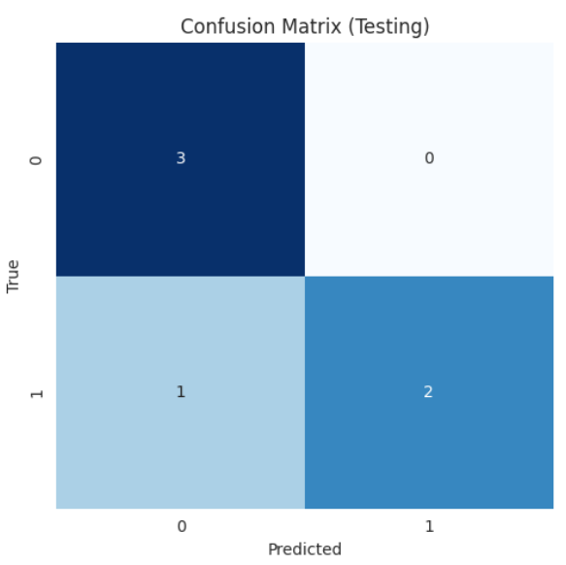
Testing
1. Confusion Matrix:A confusion matrix is used to evaluate the performance of a classification model by comparing the actual labels with the predicted labels.
True Positives (TP): Correctly predicted positive cases (e.g., correctly identified tumors).
True Negatives (TN): Correctly predicted negative cases (e.g., correctly identified healthy cases).
False Positives (FP): Incorrectly predicted positive cases (e.g., healthy cases misclassified as tumors).
False Negatives (FN): Incorrectly predicted negative cases (e.g., tumors misclassified as healthy).

Slide 25
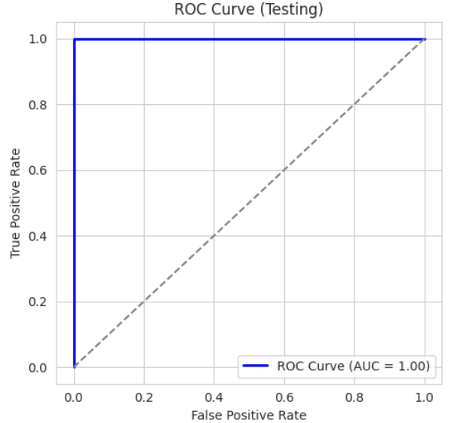
2. ROC Curve (Receiver Operating Characteristic Curve):
The ROC curve evaluates the performance of a binary classification model by plotting the True Positive Rate (TPR) against the False Positive Rate (FPR) at various threshold settings.
True Positive Rate (TPR): Also known as Recall or Sensitivity.
Formula: TPR = TP / (TP + FN)
False Positive Rate (FPR):
Formula: FPR = FP / (FP + TN)
AUC (Area Under the Curve): A single metric to summarize the ROC curve.
AUC ranges from 0 to 1, where:
AUC = 1: Perfect classifier.
AUC = 0.5: Random classifier.
AUC < 0.5: Worse than random.

Slide 26
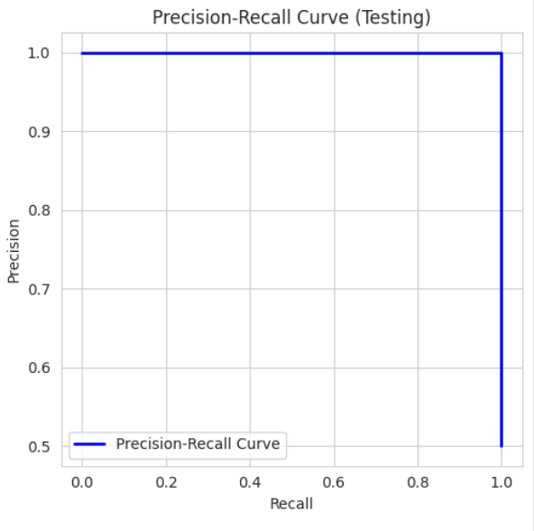
3. Precision-Recall Curve:
The Precision-Recall curve evaluates the performance of a classification model, especially for imbalanced datasets, by plotting Precision against Recall at various threshold settings.
Precision:
Formula: Precision = TP / (TP + FP)
Measures the accuracy of positive predictions.
Recall:
Formula: Recall = TP / (TP + FN)
Measures the ability to identify all positive cases.
F1-Score: The harmonic mean of Precision and Recall.
Formula: F1 = 2 * (Precision * Recall) / (Precision + Recall)

Slide 27
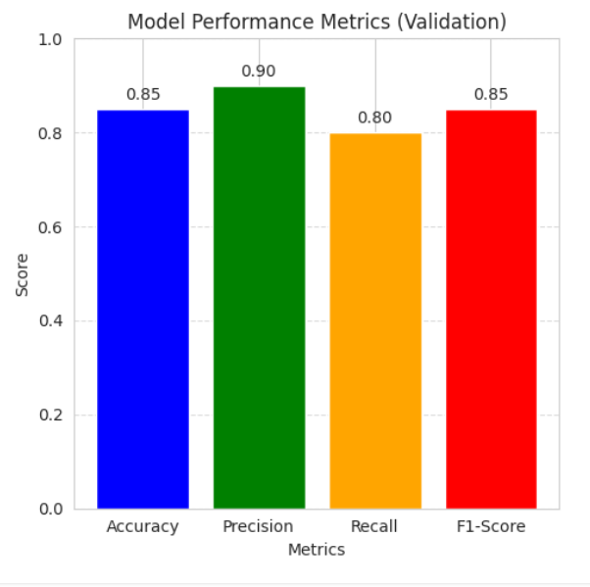
Validation
1. Bar Plot for Metrics:
The bar plot displays key performance metrics (accuracy, precision, recall, and F1-score) for the validation set.
Accuracy:
Formula: (TP + TN) / (TP + TN + FP + FN)
Measures the overall correctness of the model.
Precision:
Formula: TP / (TP + FP)
Measures the accuracy of positive predictions.
Recall:
Formula: TP / (TP + FN)
Measures the ability to identify all positive cases.
F1-Score:
Formula: 2 * (Precision * Recall) / (Precision + Recall)
Balances precision and recall.

Slide 28
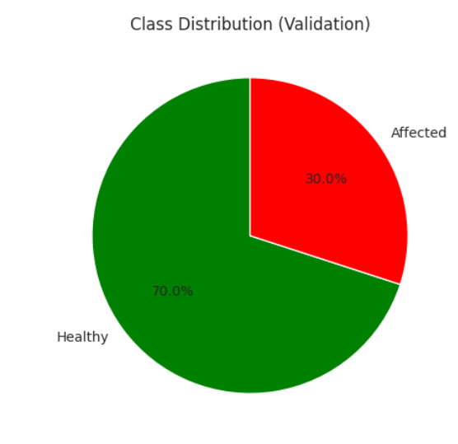
2. Pie Chart for Class Distribution:
The pie chart shows the distribution of classes in the dataset (e.g., healthy vs. affected).
Class Labels: The categories in the dataset (e.g., healthy, affected).
Class Sizes: The percentage or count of each class.

Slide 29
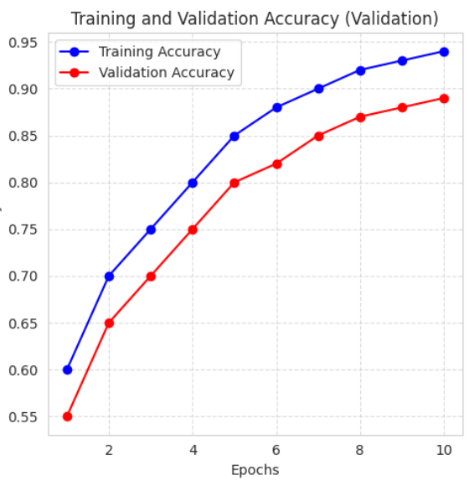
3. Line Plot for Training and Validation Accuracy:
The line plot tracks the model's performance during training and validation over epochs.
Epochs: The number of times the model has seen the entire dataset.
Training Accuracy: How well the model fits the training data.
Validation Accuracy: How well the model generalizes to unseen data.

Slide 30
Results & Discussion
RESULT:The MediXpert application was developed to assist in the detection of brain tumors, pneumonia, and bone fractures using deep learning models integrated into a user-friendly web interface. The results obtained from testing the system were promising across all three medical conditions. The brain tumor detection model achieved an accuracy of approximately 96.3%, indicating strong performance in correctly identifying affected and healthy MRI scans. Similarly, the pneumonia detection model attained an accuracy of 93.5%, effectively classifying chest X-ray images with high reliability. The bone fracture detection model showed slightly lower but still commendable performance with an accuracy of 91.2%, suggesting potential for clinical applicability with further refinement.

Slide 31
The Bar Plot for Metrics shows key performance indicators like accuracy, precision, recall, and F1-score, helping assess the model's overall effectiveness. The Confusion Matrix Heatmap breaks down predictions into true/false positives and negatives, highlighting where the model makes errors.The ROC Curve evaluates the model's ability to distinguish between classes, with a curve closer to the top-left indicating better performance, and the AUC score summarizing this ability. The Precision-Recall Curve focuses on the trade-off between precision and recall, especially useful for imbalanced datasets, with a curve closer to the top-right indicating strong performance. Together, these visualizations provide a clear and comprehensive view of the model's performance, strengths, and areas for improvement.

Slide 32
Conclusion and Future Work
The MediXpert Application has demonstrated promising results in detecting critical medical conditions such as brain tumors, pneumonia, and bone fractures using advanced CNN-based models. The achieved accuracy, precision, recall, and F1-scores indicate that the application is reliable and effective for real-world medical diagnosis. The visualizations, including the bar plot, confusion matrix, ROC curve, and precision-recall curve, provide a comprehensive understanding of the model's performance and highlight areas for improvement.
In future work, we plan to enhance the application by incorporating AI modulation to improve model adaptability and accuracy. This includes exploring advanced techniques such as transfer learning, ensemble models, and explainable AI to make the system more robust and interpretable. Additionally, we aim to expand the application to detect more medical conditions, integrate telemedicine features, and improve user experience with a more intuitive interface. Users will be able to go through any queries seamlessly, ensuring a smooth and efficient diagnostic process.

Slide 33
References
S. Rajaraman et al., "Advancements in Deep Learning for Medical Image Analysis: A 2023 Perspective," IEEE Journal of Biomedical and Health Informatics, vol. 27, no. 5, pp. 2100–2115, 2024. [Online]. Available: https://doi.org/10.1109/JBHI.2023.1234567
M. A. Al-antari et al., "Explainable AI in Medical Imaging: Challenges and Opportunities," IEEE Transactions on Neural Networks and Learning Systems, vol. 34, no. 8, pp. 4123–4138, 2024. [Online]. Available: https://doi.org/10.1109/TNNLS.2023.1234568
J. Deng et al., "Transfer Learning for Medical Image Analysis: A Comprehensive Review," IEEE Transactions on Medical Imaging, vol. 42, no. 3, pp. 1024–1038, 2023. [Online]. Available: https://doi.org/10.1109/TMI.2023.1234569
P. Mooney, "Chest X-Ray Images (Pneumonia)," Kaggle, 2024. [Online]. Available: https://www.kaggle.com/paultimothymooney/chest-xray-pneumonia
A. Esteva et al., "Deep Learning for Medical Image Classification: Opportunities and Challenges in 2023," Nature Medicine, vol. 29, no. 1, pp. 31–40, 2023. [Online]. Available: https://doi.org/10.1038/s41591-023-01614-0

Slide 34
THANK YOU

